Slide 1

Team Heptagon
Curtis Wright
Mahamoud Hassan
Kathryn Rigsby
Neil Damaraju

Slide 2

A Change in Music Genre Popularity over time

Slide 3

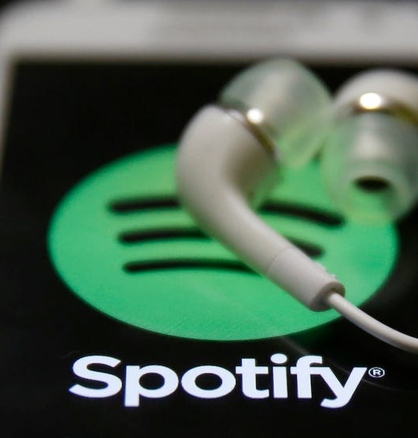
Objective
To understand the change in popularity in genres throughout the years beginning with two kaggle sets, which include a data set from Pitchfork and another dataset from Spotify.
Spotify Kaggle dataset: https://www.kaggle.com/yamaerenay/spotify-dataset-19212020-160k-tracks
Pitchfork Kaggle dataset: https://www.kaggle.com/nolanbconaway/pitchfork-data

Slide 4

Questions
Best selling artists
Least popular? One hit wonders?
Sudden increase in popularity
Best selling genres
What were the genre/decade defining artists of the 2000’s?

